Slide 1
Blockchain Based Customer Reward Management System
Gopika V Baburaj
MCA S3-A
Roll No:54

Slide 2
Objective of study
To build a platform that provide transparency and security in Customer Reward Management using blockchain, which has no expiry date.

Slide 3
Customer Reward Management system
A customer reward management system or customer loyalty program is a program run by a company that offers benefits to frequent customers.
Those benefits may be in the form of discounts, rebates, free products, or other promotions.

Slide 4
Description
As a demo, we are implementing blockchain based reward management system in an online shopping site.
The reward allocating here is discount coupon.
The shops or shopkeepers can add these coupons and block chain admin can approve or reject the coupon based on certain criteria.
Here the criteria used is price range

Slide 5
Shop
Emp 1
Emp 2
Emp 3
Emp 4
Emp 5
Blockchain admins

Slide 6
Modules
1. Coupon Management – Blockchain is implemented here
2. Customer registration
3. Product Management
4. Purchase Management

Slide 7
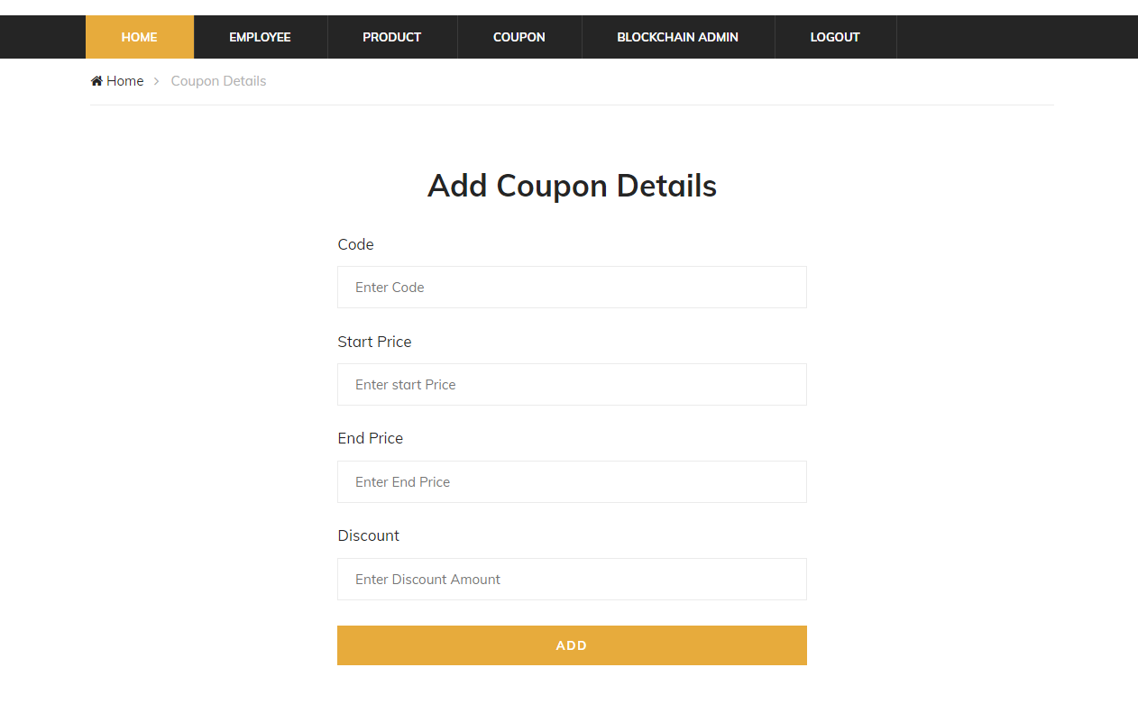
1. Coupon Management - Add Coupon

Slide 8
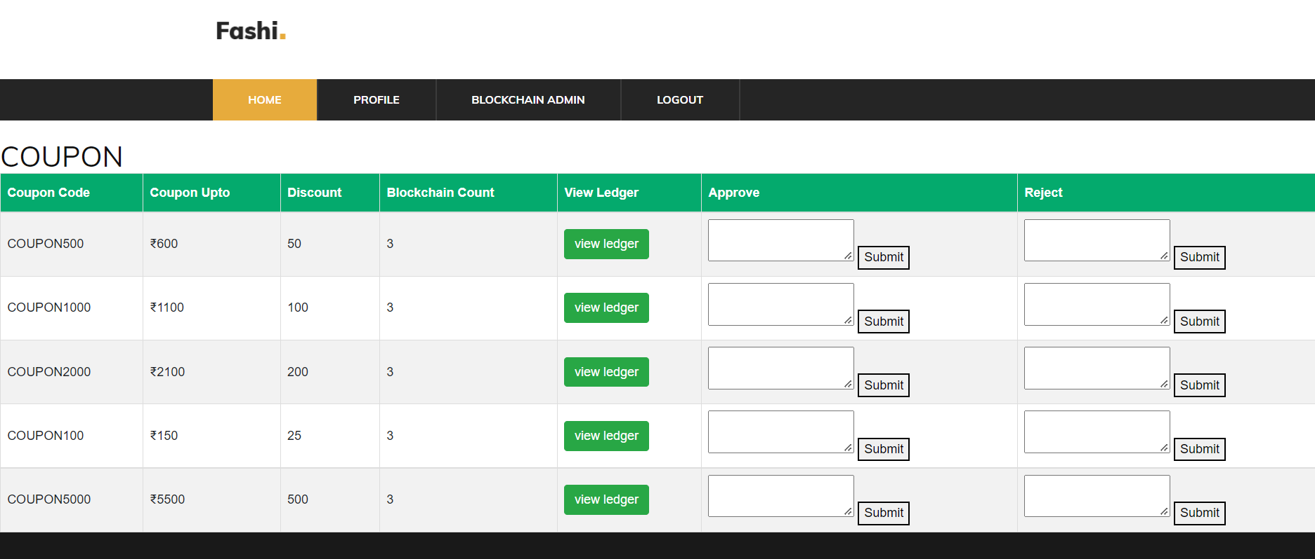
1. Coupon Management - Approve or reject coupon

Slide 9
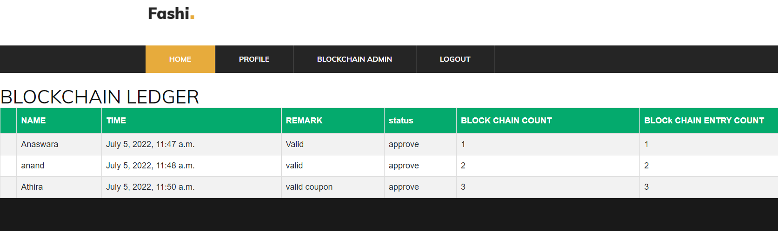
1. Coupon Management - View ledger

Slide 10
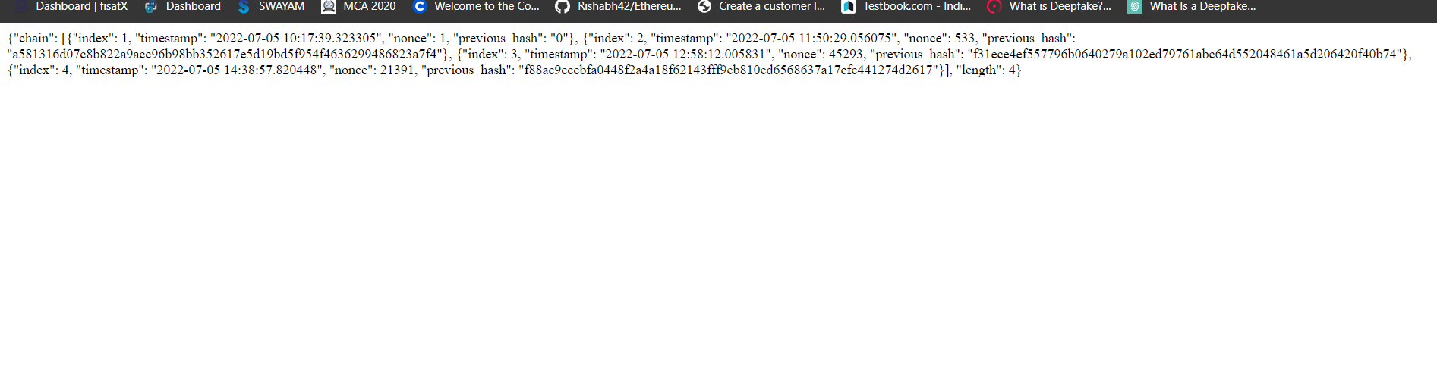
1. Coupon Management - View blocks

Slide 11
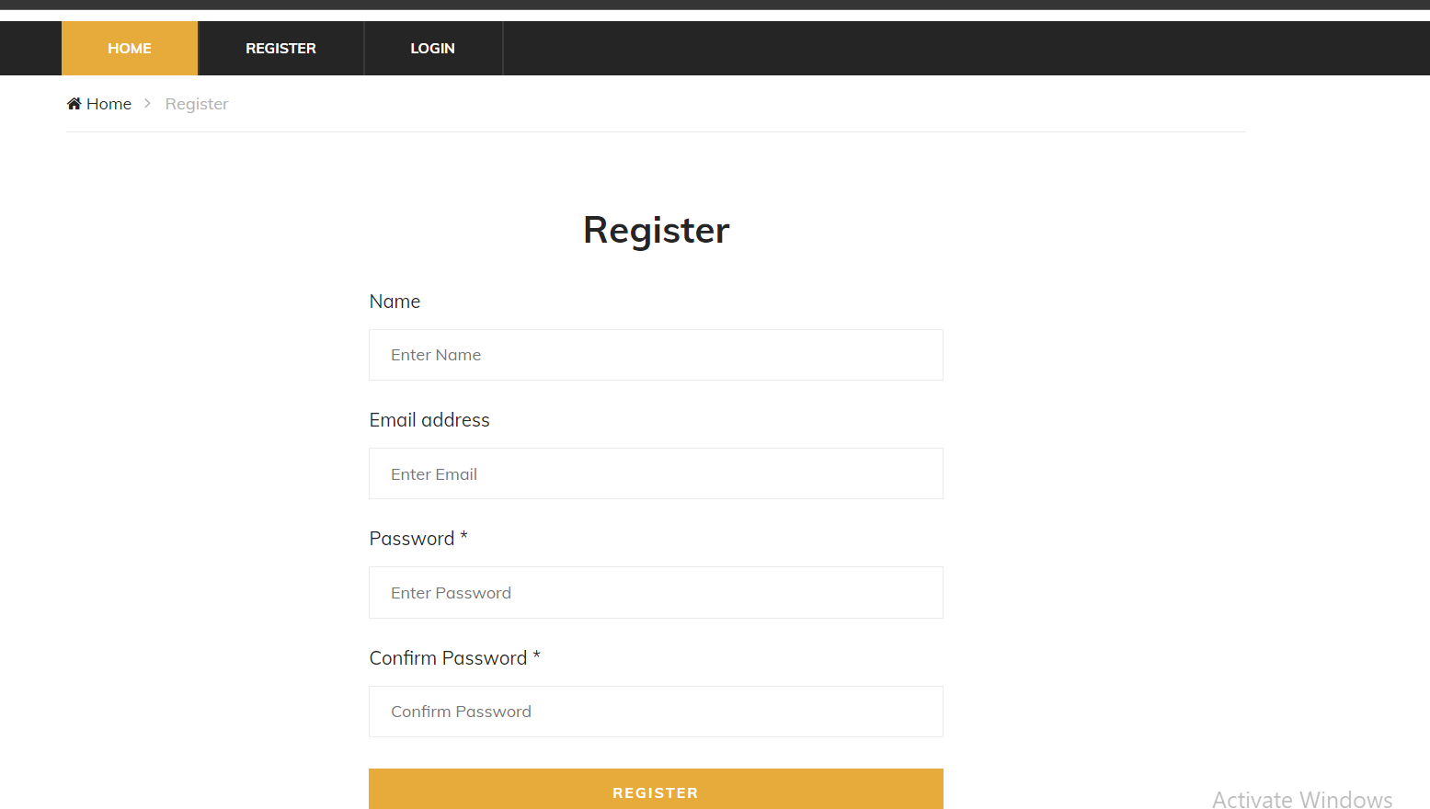
2. Customer registration

Slide 12
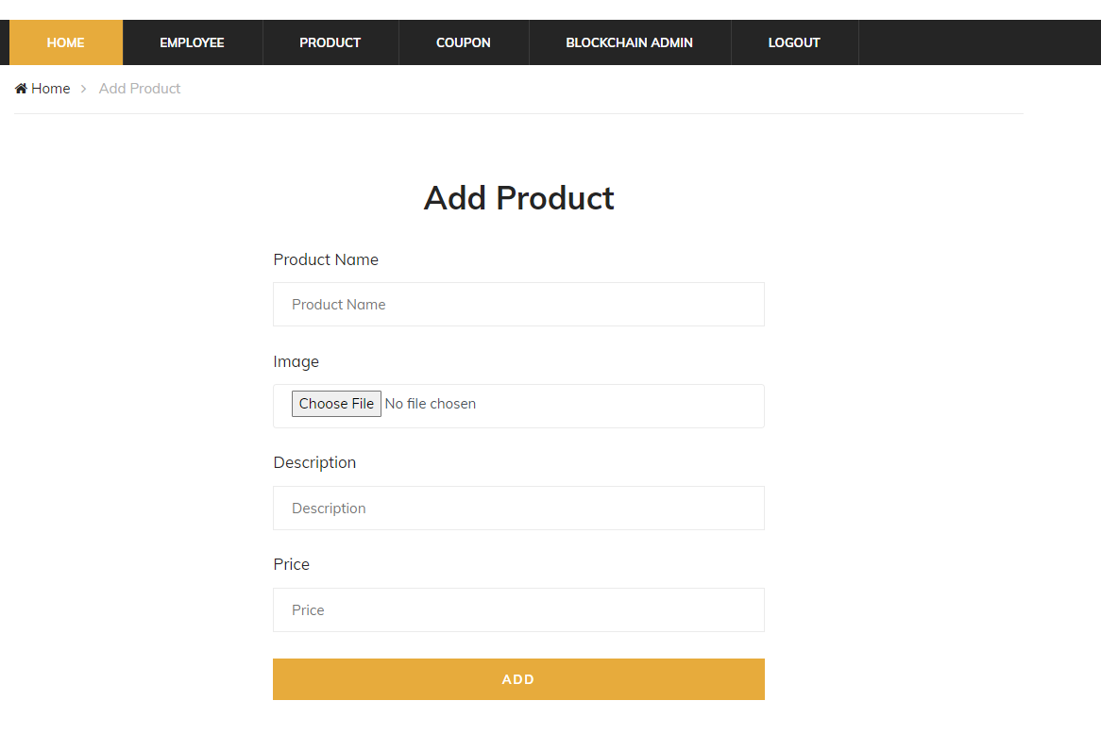
3. Product Management - Add Product

Slide 13
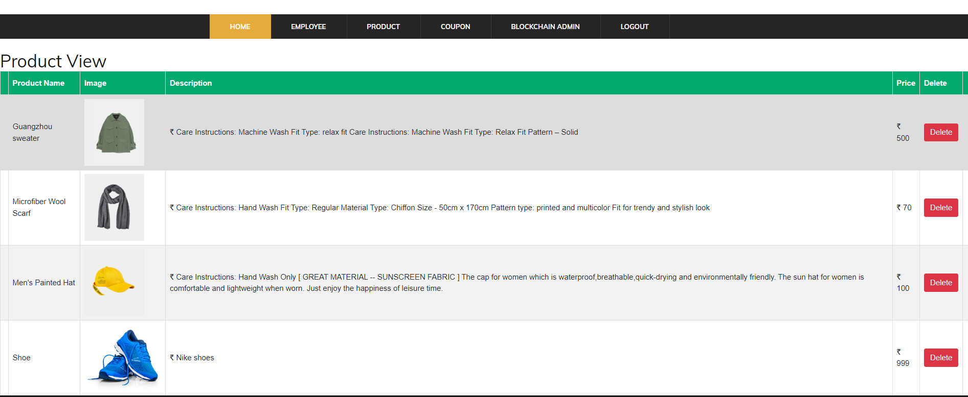
3.Product Management - View Product

Slide 14
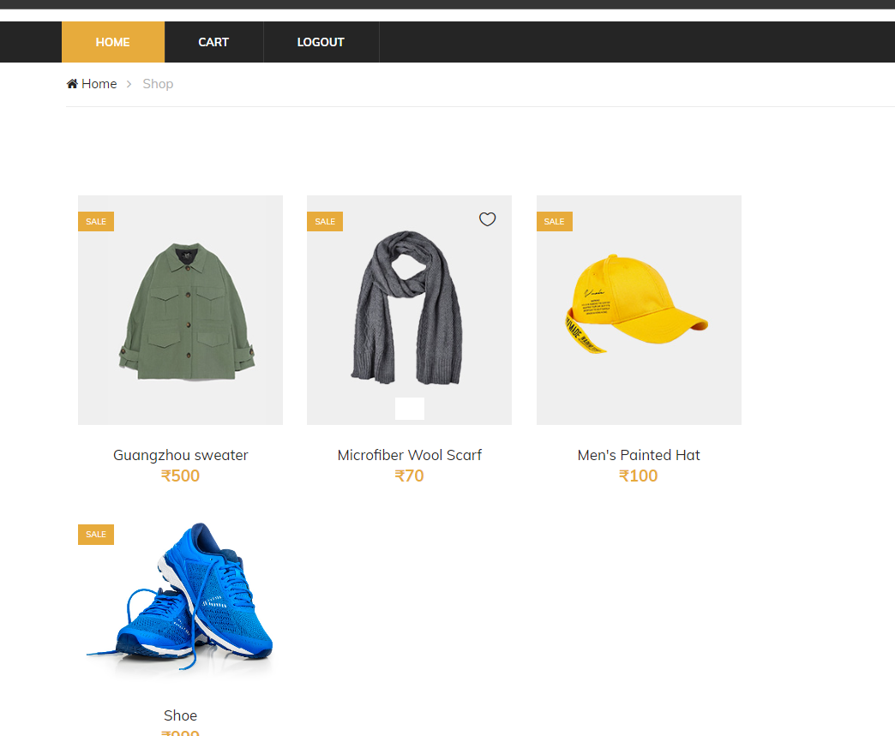
4. Purchase Management - Purchase online

Slide 15
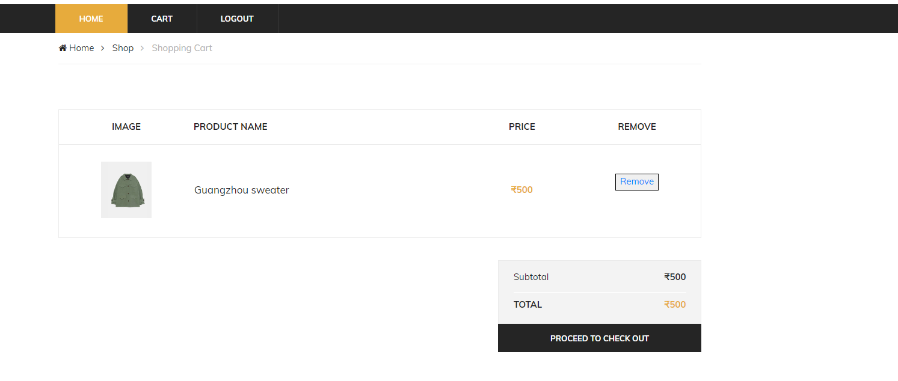
4. Purchase Management - Add to cart

Slide 16
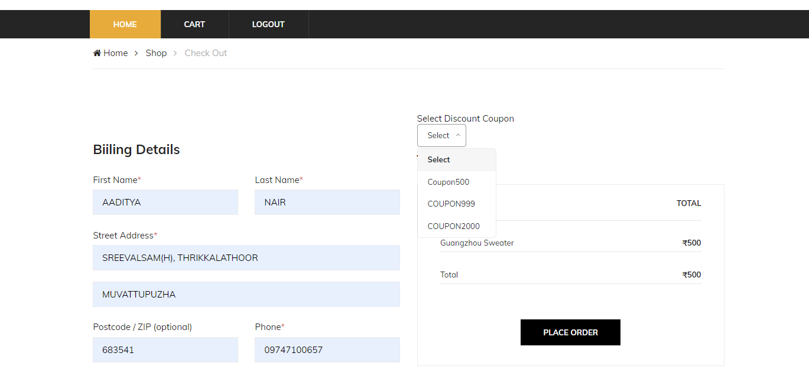
2. Purchase Management - Payment and valid coupon are displayed

Slide 17
Thank You!!!

